Slide 1
Serial Communication in 8051

Slide 2
Objectives
Contrast and compare serial versus parallel communication
Contrast synchronous versus asynchronous communication
Contrast half-versus full-duplex transmission
Understand the basics of serial communication- data framing and data transfer rate
Define the RS232 standard and handshaking signals
Understand various Serial Modes
Write Codes to transmit and receive data serially in Mode 1
Understand Doubling the Baud rate in 8051
Exploring Second Serial Port of 8051 based controllers
Discover the Power saving modes in 8051

Slide 3
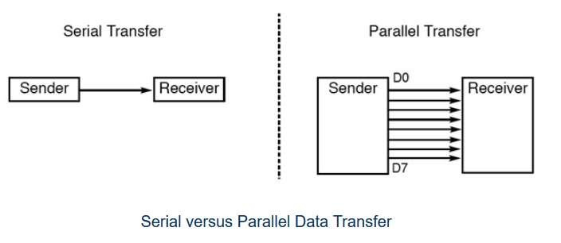
Serial v/s Parallel Communication

Slide 4
Serial v/s Parallel Communication
Parallel Communication | Serial Communication
Often 8 or more lines (wire conductors) are used to transfer data. Multiple bits are transferred at a time. | The data is sent one bit at a time on a single line (wire)
Preferred for short-distance communication | Preferred over long-distance communication
Costly as more resources are required | Comparatively cheaper
Speed of data transfer is high | Slow
Example: SPI, I2C, UART | Example: PCI

Slide 5
Basics of Serial Communication
Serial communication uses single data line making it much cheaper
Enables two computers in different cities to communicate over the telephone
Byte of data must be converted to serial bits using a parallel-in-serial- out shift register and transmitted over a single data line
At the receiving end there must be a serial-in-parallel-out shift register
If transferred on the telephone line, it must be converted to audio tones by modem for short distance

Slide 6
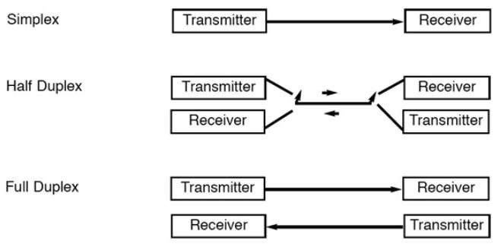
Modes of Serial Communication

Slide 7
Modes of Serial Communication
In simplex transmissions, the computer can only send data. There is only one wire.
If the data can be transmitted and received, then it is a duplex transmission
Duplex transmissions can be half or full duplex depending on whether or not the data transfer can be simultaneous
If the communication is only one way at a time, it is half duplex
If both sides can communicate at the same time, it is full duplex
Full duplex requires two wire conductors for the data lines (in addition to the signal ground)

Slide 8
Basics of Serial Communication
Serial Communication can be
Asynchronous
Synchronous
Synchronous Communication
Synchronous methods transfer a block of data (characters) at a time
The events are referenced to a clock
Example: SPI bus, I2C bus
Asynchronous Communication
Asynchronous methods transfer a single byte at a time
There is no clock. The bytes are separated by start and stop bits.
Example: UART

Slide 9
Basics of Serial Communication
To support serial communication, special interfaces are built in the microcontroller.
The microcontrollers use special IC chips called UART (universal asynchronous receiver-transmitter) and USART (universal synchronous asynchronous receiver-transmitter)
8051 chip has a built-in UART

Slide 10
Data Framing in Asynchronous Serial Communication
Data is transmitted in 0s and 1s
To have a sense of synchronization between transmitter and receiver and to make sense of the data, transmitter and receiver agree on a set of rules i.e protocol, which describes
how the data is packed
how many bits constitute a character
when the data begins and ends

Slide 11
Data Framing in Asynchronous Serial Communication
Start and stop bits
Each character is placed between start and stop bits. This is called framing.
Start bit is always one bit, stop bit can be one, two or one and half bits
In 8051 serial port, when there is no transmission, the TxD line is held high. This is called mark.
Start bit is always a 0 (low), stop bit(s) is 1 (high)
LSB is sent out first

Slide 12
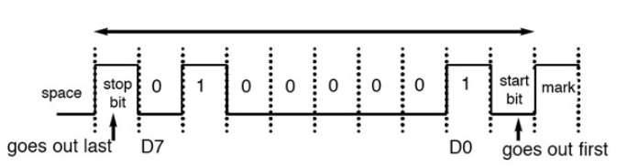
Data Framing in Asynchronous Serial Communication
Framing ASCII A
The transmission begins with a start bit, followed by the LSB(D₀), then the rest of the bits until MSB (D₇), and finally, the one stop bit indicating the end of the character
When there is no transfer, the signal is 1 (high), which is referred
to as mark

Slide 13
Data Framing in Asynchronous Serial Communication
Assuming that we are transferring characters using 1 stop bit, we have a total of 10 bits for each character
This gives 25% overhead, i.e. each 8-bit character with an extra 2 bits
In some systems in order to maintain data integrity, the parity bit of the character byte is included in the data frame
UART chips allow programming of the parity bit for odd, even, and no-parity options

Slide 14
Data Transfer Rate in Asynchronous Serial Communication
The rate of data transfer in serial data communication is stated in bps (bits per second)
Another widely used terminology for bps is baud rate
It is modem terminology and is defined as the number of signal changes per second
In modems, there are occasions when a single change of signal transfers several bits of data
As far as the conductor wire is concerned, the baud rate and bps are the same, and we use the terms interchangeably
The data transfer rate of given computer system depends on communication ports incorporated into that system
IBM PC/XT could transfer data at rate of 100 to 9600 bps

Slide 15
RS232 Standards
An interfacing standard RS232 was set by the Electronics Industries Association (EIA) in 1960
In RS232, a 1 is represented by -3 ~ -25 V, while a 0 bit is +3 ~
+25 V, making -3 to +3 undefined
The standard was set long before the advent of the TTL logic family, its input and output voltage levels are not TTL compatible
A microcontroller system must use voltage converters such as MAX232 to convert the TTL logic levels to the RS232 voltage levels, and vice versa
MAX232 IC chips are commonly referred to as line drivers

Slide 16
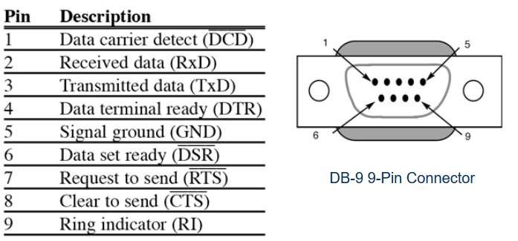
DB9 pin connections
RS232 supports both DB25 and DB 9 pin connector
DB-9 Pin Connector

Slide 17
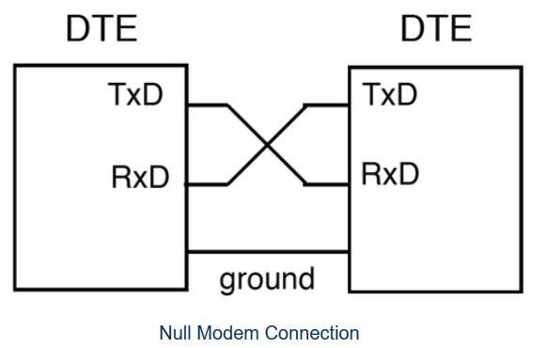
Handshaking in Rs232
Current terminology classifies data communication equipment as
DTE (data terminal equipment) refers to terminal and
computers that send and receive data
DCE (data communication equipment) refers to communication equipment, such as modems
The simplest connection between a PC and microcontroller requires a minimum of three pins, TxD, RxD, and ground

Slide 18
Handshaking signals in Rs232
DTR (data terminal ready)
When terminal is turned on, it sends out signal DTR to indicate that it is ready for communication
DSR (data set ready)
When DCE is turned on and has gone through the self-test, it assert DSR to indicate that it is ready to communicate
RTS (request to send)
When the DTE device has byte to transmit, it assert RTS to signal the modem that it has a byte of data to transmit
CTS (clear to send)
When the modem has room for storing the data it is to receive, it sends out
signal CTS to DTE to indicate that it can receive the data now

Slide 19
Handshaking signals in Rs232
DCD (data carrier detect)
The modem asserts signal DCD to inform the DTE that a valid carrier has been detected and that contact between it and the other modem is established
RI (ring indicator)
An output from the modem and an input to a PC indicates that the telephone is ringing
It goes on and off in synchronous with the ringing sound

Slide 20
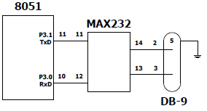
TxD and RxD in 8051
8051 has two pins that are used specifically for transferring and receiving data serially
These two pins are called TxD and RxD and are part of the port 3 group (P3.0 and P3.1)
These pins are TTL compatible; therefore, they require a line driver to make them RS232 compatible
We need a line driver (voltage converter) to convert the R232’s signals to TTL voltage levels that will be acceptable to 8051’s TxD and RxD pins

Slide 21
PC Baud rate
PC/compatible COM ports PC/compatible computers (Pentium) microprocessors normally have two COM ports
Both ports have RS232-type connectors
COM ports are designated as COM 1 and COM 2 (replaced by USB ports)
To allow data transfer between the PC and an 8051 system without any error, we must make sure that the baud rate of 8051 system matches the baud rate of the PC’s COM port
Baud rate supported by IBM PC: 19200, 9600, 4800, 2400, 1200,
600, 300, 150 and 110

Slide 22
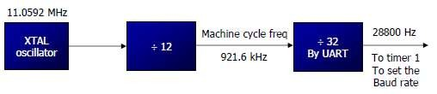
Setting Baud rate in 8051
Baud rate in the 8051 baud rate in the 8051 is programmable
Relationship between the crystal frequency and the baud rate in the 8051
8051 divides the crystal frequency by 12 to get the machine cycle frequency
XTAL = 11.0592 MHz, the machine cycle frequency is 921.6 kHz 8051's UART divides the machine cycle frequency of 921.6 kHz by 32 once more before it is used by Timer 1 to set the baud rate 921.6 kHz divided by 32 gives 28,800 Hz

Slide 23
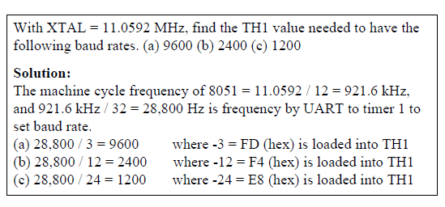
Setting Baud rate in 8051
Timer 1 must be programmed in mode 2, that is 8-bit, auto-reload

Slide 24
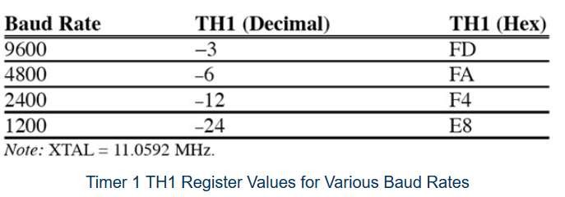
Setting Baud rate in 8051
Timer 1 must be programmed in mode 2, that is 8-bit, auto-reload

Slide 25
SBUF Register
A byte of data to be transferred via the TxD line must be placed in the SBUF register
SBUF holds the byte of data when it is received by the RxD line
SBUF can be accessed like any other register
MOV SBUF, #'D' ;load SBUF=44H, ASCII for 'D‘
MOV SBUF, A
MOV A, SBUF
;copy accumulator into SBUF
;copy SBUF into accumulator
When a byte is written in SBUF, it is framed by 8051 with the start and stop bits and transferred serially via the TxD pin
When the bits are received serially via RxD, it is deframed by 8051 by eliminating the stop and start bits, making a byte out of the data received, and then placing it in the SBUF
Framing need not be done by programmer explicitly

Slide 26
SBUF Register
The special function register SBUF is physically two registers.
One is, write-only and is used to hold data to be transmitted out
of the 8051 via TXD.
The other is, read-only and holds the received data from external sources via RXD.
Both mutually exclusive registers have the same address 099H.
SBUF is not bit addressable

Slide 27
SCON Register
SCON is an 8-bit register used to program the start bit, stop bit, and data bits of data framing, among other Things
SM0 : Serial Mode Specifier
SM1 : Serial Mode Speceifier
SM2 : Used for multiprocessor Communication
REN : Set/Cleared by Software to enable/disable reception
TB8 : not used in Mode 1
RB8 : Not used in Mode 1
TI : Transmit interrupt flag. Set by HW at the begin of the stop bit mode 1. And cleared by SW
RI : Receive interrupt flag. Set by HW at the begin of the stop bit mode 1.
And cleared by SW
SM0 | SM1 | SM2 | REN | TB8 | RB8 | TI | RI

Slide 28
SCON Register
SM0, SM1 determine the framing of data by specifying the number of bits per character, and the start and stop bits
SM0 | SM1 | Serial Mode
0 | 0 | Mode 0
0 | 1 | Mode 1
1 | 0 | Mode 2
1 | 1 | Mode 3

Slide 29
Serial Data Transmission Modes
Mode 0
In this mode, the serial port works like a shift register and the data transmission works synchronously with a clock frequency of f_{osc} /12.
Serial data is received and transmitted through RXD.
8 bits are transmitted/ received at a time.
Pin TXD outputs the shift clock pulses of frequency f_{osc} /12, which is connected to the external circuitry for synchronization.
The shift frequency or baud rate is always 1/12 of the oscillator frequency.

Slide 30
Serial Data Transmission Modes
Mode 1
In mode-1, the serial port functions as a standard Universal
Asynchronous Receiver Transmitter (UART) mode.
10 bits are transmitted through TXD or received through RXD.
The 10 bits consist of one start bit (which is usually '0'), 8 data bits (LSB is sent first/received first), and a stop bit (which is usually '1').
Once received, the stop bit goes into RB8 in the special function register SCON. The baud rate is variable.

Slide 31
Serial Data Transmission Modes
Mode 2
In this mode 11 bits are transmitted through TXD or received through
RXD.
The various bits are as follows: a start bit (usually '0'), 8 data bits (LSB first), a programmable 9 ^{th} (TB8 or RB8)bit and a stop bit (usually '1').
While transmitting, the 9 ^{th} data bit (TB8 in SCON) can be assigned the value '0' or '1'.
For example, if the information of parity is to be transmitted, the parity bit (P) in PSW could be moved into TB8. On reception of the
₉ th
data, the bit goes into RB8 in 'SCON', while the stop bit is ignored.
The baud rate is programmable to either 1/32 or 1/64 of the oscillator
frequency.
f _{baud} = (2 ^{SMOD} /64) f_{osc}.
•

Slide 32
Serial Data Transmission Modes
Mode 3
In this mode 11 bits are transmitted through TXD or received
through RXD.
The various bits are: a start bit (usually '0'), 8 data bits (LSB first), a programmable 9 th bit and a stop bit (usually '1').
Mode-3 is same as mode-2, except the fact that the baud rate in
mode-3 is variable (i.e., just as in mode-1).
f _{baud} = (2 ^{SMOD} /32) * ( f_{osc} / 12 (256-TH1)) .
This baud rate holds when Timer-1 is programmed in Mode-2.

Slide 33
TI and RI Flags
TI (transmit interrupt)
When 8051 finishes the transfer of the 8-bit character, it raises the TI flag to indicate that it is ready to transfer another byte
TI bit is raised at the beginning of the stop bit
RI (receive interrupt)
When the 8051 receives data serially via RxD, it places the byte in the SBUF register then raises the RI flag bit to indicate that a byte has been received and should be picked up before it is lost
RI is raised halfway through the stop bit

Slide 34
Programming the 8051 to transfer character bytes serially
TMOD register is loaded with the value 20H, indicating the use of
timer 1 in mode 2 (8-bit auto-reload) to set baud rate
The TH1 is loaded with one of the value to set baud rate for serial data transfer
The SCON register is loaded with the value 50H, indicating serial mode 1, where an 8- bit data is framed with start and stop bits
TR1 is set to 1 to start timer 1
TI is cleared by CLR TI instruction
The character byte to be transferred serially is written into SBUF register
The TI flag bit is monitored with the use of instruction JNB TI,xx to see if the character has been transferred completely
To transfer the next byte, go to step 5

Slide 35
Steps that 8051 goes through in transmitting a character via TxD
The byte character to be transmitted is written into the SBUF register
The start bit is transferred
The 8-bit character is transferred on bit at a time
The stop bit is transferred
It is during the transfer of the stop bit that 8051 raises the TI flag, indicating that the last character was transmitted
By monitoring the TI flag, we make sure that we are not overloading
the SBUF
If we write another byte into the SBUF before TI is raised, the untransmitted portion of the previous byte will be lost
After SBUF is loaded with a new byte, the TI flag bit must be forced to
0 by CLR TI in order for this new byte to be transferred

Slide 36
Importance of TI Flag
By checking the TI flag bit, we know whether or not the 8051 is ready to transfer another byte
If we write a byte into SBUF before the TI flag bit is raised, we risk the loss of a portion of the byte being transferred

Slide 37
Programming the 8051 to receive character bytes serially
TMOD register is loaded with the value 20H, indicating the use of
timer 1 in mode 2 (8-bit auto-reload) to set baud rate
The TH1 is loaded with one of the value to set baud rate for serial data transfer
The SCON register is loaded with the value 50H, indicating serial mode 1, where an 8- bit data is framed with start and stop bits
TR1 is set to 1 to start timer 1
RI is cleared by CLR RI instruction
The RI flag bit is monitored with the use of instruction JNB RI,xx to see if the entire character has been received yet
When RI is raised, SBUF has the byte, its contents are moved into a safe place
To transfer the next byte, go to step 5

Slide 38
Steps that 8051 goes through in receiving a character via RxD
It receives the start bit
Indicating that the next bit is the first bit of the character byte it is about
to receive
The 8-bit character is received one bit at time
The stop bit is received
When receiving the stop bit 8051 makes RI = 1, indicating that an entire character byte has been received and must be picked up before it gets overwritten by an incoming character
By checking the RI flag bit when it is raised, we know that a character has been received and is sitting in the SBUF register
We copy the SBUF contents to a safe place in some other register or memory before it is lost
After the SBUF contents are copied into a safe place, the RI flag bit must be forced to 0 by CLR RI in order to allow the next received character byte to be placed in SBUF
Failure to do this causes loss of the received character

Slide 39
Importance of RI Flag
By checking the RI flag bit, we know whether or not the 8051 received a character byte
If we copy SBUF into a safe place before the RI flag bit is raised, we risk copying garbage

Slide 40
Steps that 8051 goes through in receiving a character via RxD
It receives the start bit
Indicating that the next bit is the first bit of the character byte it is about
to receive
The 8-bit character is received one bit at time
The stop bit is received
When receiving the stop bit 8051 makes RI = 1, indicating that an entire character byte has been received and must be picked up before it gets overwritten by an incoming character
By checking the RI flag bit when it is raised, we know that a character has been received and is sitting in the SBUF register
We copy the SBUF contents to a safe place in some other register or memory before it is lost
After the SBUF contents are copied into a safe place, the RI flag bit must be forced to 0 by CLR RI in order to allow the next received character byte to be placed in SBUF
Failure to do this causes loss of the received character

Slide 41
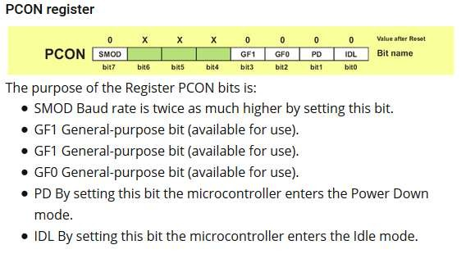
PCON register and Power Saving Modes in 8051

Slide 42
PCON register and Power Saving Modes in 8051
Generally, the microcontroller is inactive for the most part and just waits for some external signal in order to takes its role in a show.
This can cause some problems in case batteries are used for power supply.
In extreme cases, the only solution is to set the whole electronics in sleep mode in order to minimize consumption.

Slide 43
PCON register and Power Saving Modes in 8051
Idle Mode
Upon the IDL bit of the PCON register is set, the microcontroller turns off the CPU unit while peripheral units such as serial port, timers and interrupt system continue operating normally
In Idle mode, the state of all registers and I/O ports remains
unchanged.
In order to exit the Idle mode and make the microcontroller operate normally, it is necessary to reset.
It will cause the IDL bit to be automatically cleared and the program resumes operation from instruction having set the IDL bit.

Slide 44
PCON register and Power Saving Modes in 8051
Power Down Mode
By setting the PD bit of the PCON register from within the
program, the microcontroller is set to Power down mode,
In power down mode, internal oscillator is off and reduces power consumption enormously.
The only way to get the microcontroller back to normal mode is by reset.
While the microcontroller is in Power Down mode, the state of all SFR registers and I/O ports remains unchanged.
By setting it back into the normal mode, the contents of the SFR register is lost, but the content of internal RAM is saved.

